Slide 1
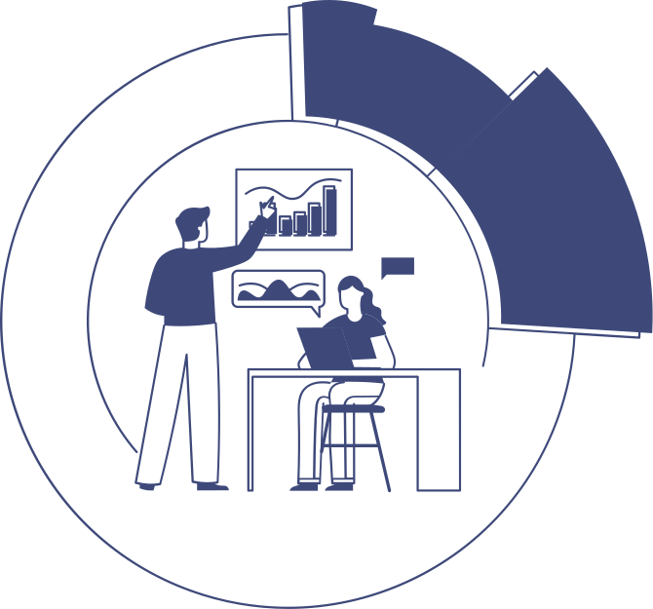

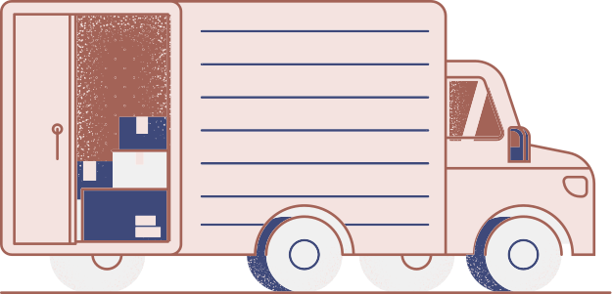
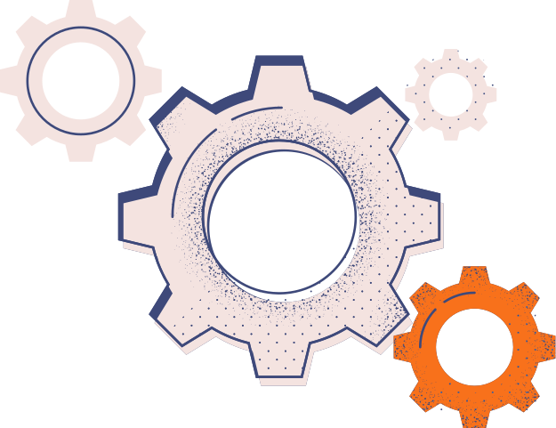
MARKETING FUNDAMENTALS

Slide 2


MARKETING FUNDAMENTALS
WHAT
ARE
MARKETING FUNDAMENTALS?
Marketing fundamentals are essential principles that guide the development and execution of marketing strategies to promote products or services effectively.

Slide 3
Unique Selling Proposition (USP): Your USP is what sets your product or service apart from competitors. It highlights the unique benefits that customers can expect, helping to differentiate your brand in the marketplace.
Marketing Mix (4 Ps):
Product: Refers to the tangible or intangible offering that satisfies a customer's need or desire. This includes features, design, quality, and packaging.
Price: Determining the optimal price point considering factors like production costs, competition, and perceived value by customers.
Place: Deciding the distribution channels through which products/services will be made available to customers.
Promotion: Developing strategies to communicate with and persuade target customers through advertising, public relations, sales promotion, and other promotional activities
MARKETING FUNDAMENTALS
Target Audience Identification: Understanding your target audience is crucial. This involves researching demographics, psychographics, behaviors, and preferences of potential customers to tailor your marketing efforts effectively.
Market Research: Conducting thorough market research helps in understanding industry trends, competitor strategies, and customer needs. This information is vital for creating products/services that meet market demands.

Slide 4
Place: Also known as distribution, this P focuses on how your product or service is made available to customers. Distribution channels may include direct sales, retail stores, e-commerce platforms, wholesalers, and more. The goal is to ensure that your product is easily accessible to your target market.
Promotion: Promotion encompasses all the activities aimed at communicating the value of your product or service to potential customers and persuading them to buy. This includes advertising, public relations, sales promotions, direct marketing, personal selling, and digital marketing strategies.
People: In service-based industries especially, people play a critical role in delivering the service experience. This P refers to all individuals involved in the delivery of the product or service, including employees, customer service representatives, salespeople, customersthemselves.
7 P OF MARKETING
Product: This remains at the core of marketing. It refers to the tangible or intangible goods and services that fulfill the needs or desires of customers. Product decisions include features, quality, design, branding, packaging, and more.
Price: Pricing strategy involves determining the optimal price for your product or service. Factors to consider include production costs, competitor pricing, perceived value by customers, pricing objectives (e.g., profit maximization, market share growth), and pricing tactics (e.g., discounts, bundling).

Slide 5
7 P OF MARKETING
These 7 Ps provide a comprehensive framework for developing and implementing marketing strategies that address various aspects of the marketing mix and customer experience. By considering each of these elements, businesses can better understand and meet the needs of their target market, ultimately driving success and profitability.
Process: The process refers to the systems and procedures involved in delivering your product or service. It includes everything from order processing and fulfillment to customer service and support. A well-defined and efficient process can enhance customer satisfaction and loyalty.
Physical Evidence: This P relates to the tangible elements that customers experience when interacting with your brand. It includes physical facilities, equipment, packaging, branding materials, and any other tangible touchpoints. Physical evidence can influence customers' perceptions of your brand and product quality.

Slide 6
CUSTOMER JOURNEY:AIDA

Slide 7
Attention: This is the initial stage where the goal is to grab the customer's attention and create awareness about your product or service. Strategies to capture attention include eye-catching advertisements, compelling headlines, social media posts, and other marketing efforts that stand out in a crowded marketplace.
Interest: Once you have the customer's attention, the next step is to pique their interest and engage them further. This involves providing more information about your product or service, highlighting its features and benefits, and addressing the customer's needs or pain points.
Desire: In this stage, the goal is to cultivate desire and convince the customer that your product or service is the solution they need. You can achieve this by emphasizing the unique selling points, demonstrating value, and creating a sense of urgency or exclusivity through limited-time offers or special promotions.
CUSTOMER JOURNEY:AIDA
The AIDA model is a classic framework used in marketing to understand and map out the stages a customer goes through when making a purchasing decision. AIDA stands for Attention, Interest, Desire, and Action. Here's how each stage of the AIDA model relates to the customer journey:

Slide 8
PRESENTATION SKILLS

Slide 9
3. Organize Your Content: Structure your presentation in a logical and coherent manner, with a clear introduction, main points, and conclusion. Use visual aids, such as slides or props, to support your message and enhance audience understanding.
4. Engage Your Audience: Keep your audience engaged and interested by using storytelling, anecdotes, humor, and interactive elements. Encourage participation through questions, polls, or discussions.
5. Practice, Practice, Practice: Rehearse your presentation multiple times to become familiar with the content and delivery. Practice in front of a mirror, record yourself, or rehearse with a friend or colleague for feedback.
6. Focus on Body Language: Pay attention to your body language, gestures, posture, and facial expressions. Maintain eye contact with your audience, use open and confident body language, and avoid distracting mannerisms.
PRESENTATION SKILLS
Presentation skills are essential for effectively communicating ideas, persuading audiences, and inspiring action. Here are some key tips to improve your presentation skills:
Know Your Audience: Understand who you are presenting to and tailor your content and delivery style to their preferences, interests, and knowledge level.
Clarify Your Objective: Clearly define the purpose of your presentation and what you want your audience to take away from it. This will guide your content development and delivery.

Slide 10
PRESENTATION SKILLS
9. Handle Questions Effectively: Be prepared to answer questions from your audience confidently and respectfully. Listen carefully, repeat the question if necessary, and provide concise and relevant answers.
Seek Feedback: After your presentation, solicit feedback from your audience or peers to identify strengths and areas for improvement. Use this feedback to refine your skills and enhance future presentations.
By incorporating these tips and techniques into your presentations, you can enhance your effectiveness as a presenter and deliver compelling and memorable presentations that resonate with your audience.
7. Speak Clearly and Confidently: Project your voice, speak at a moderate pace, and enunciate your words clearly. Use pauses effectively to emphasize key points and allow time for reflection.
8. Manage Nervousness: It's natural to feel nervous before a presentation, but practice relaxation techniques such as deep breathing, visualization, or positive self-talk to calm your nerves. Focus on your message and the value you are providing to your audience.

Slide 11
WEBSITE BASICS

Slide 12
3. Responsive Design: Ensure your website is mobile-friendly and responsive, meaning it adapts seamlessly to different screen sizes and devices. With the increasing use of smartphones and tablets, mobile compatibility is essential for providing a positive user experience.
4. Content Management System (CMS): Choose a CMS platform such as WordPress, Joomla, or Drupal to build and manage your website. CMS platforms offer user-friendly interfaces, customizable templates, and plugins/extensions to enhance functionality.
5. Content Strategy: Develop a content strategy that includes creating high-quality, relevant, and engaging content for your website. This may include blog posts, articles, videos, infographics, case studies, and product/service descriptions. Regularly updating your content helps attract and retain visitors and improves search engine rankings.
WEBSITE BASICS
Domain Name: Choose a domain name that is easy to remember, relevant to your business, and preferably includes keywords related to your products or services. Ensure it is unique and reflects your brand identity.
Web Hosting: Select a reliable web hosting provider that offers sufficient bandwidth, storage, and uptime guarantees to ensure your website is accessible to visitors at all times.
Website Design and Layout: Create a visually appealing and user-friendly website design that aligns with your brand image and makes it easy for visitors to navigate and find information. Use clear navigation menus, consistent branding elements, and intuitive layouts.

Slide 13
6. Call to Action (CTA): Include clear and compelling calls to action throughout your website to encourage visitors to take desired actions, such as making a purchase, subscribing to a newsletter, downloading a resource, or contacting you for more information.
7. Security: Protect your website from security threats and data breaches by implementing security measures such as SSL certificates, regular software updates, strong passwords, and security plugins.
By paying attention to these website basics in your digital marketing efforts, you can create a professional, functional, and effective website that attracts visitors, engages them with valuable content, and drives conversions and business growth.
WEBSITE BASICS
4. Search Engine Optimization (SEO): Optimize your website for search engines to improve its visibility and rankings in search engine results pages (SERPs). This involves keyword research, on-page optimization (meta tags, headings, URLs, etc.), off-page optimization (backlink building), and technical optimization (site speed, mobile-friendliness, etc.).
5. Analytics and Tracking: Implement web analytics tools such as Google Analytics to track visitor behavior, monitor website performance, and gather insights into user demographics, traffic sources, and conversion rates. Use this data to make informed decisions and optimize your digital marketing strategies.

Slide 14
SEO: SEARCH ENGINE OPTIMIZATION

Slide 15
SEARCH ENGINE OPTIMIZATION
WHAT
IS SEO ?
Process: SEO is the process of optimizing a website or online content to improve its visibility and ranking in search engine results pages (SERPs).
Goal: The ultimate goal of SEO is to attract organic (non-paid) traffic to the website by enhancing its relevance, authority, and trustworthiness in the eyes of search engines like Google, Bing, and Yahoo.

Slide 16



FOUR FACTORS OF SEO?
ON-PAGE OPTIMIZATION:
CONTENT QUALITY AND RELEVANCE
BACKLINKS AND LINK BUILDING:
TECHNICAL OPTIMIZATION:
This includes optimizing individual web pages to improve their visibility and relevance for specific keywords or topics. On-page factors include elements such as keyword usage, meta tags, headings, URL structure, and internal linking.
High-quality, relevant content is essential for SEO success. Content should be well-written, informative, and engaging for users, while also incorporating relevant keywords and addressing user intent. Fresh and regularly updated content can also positively impact SEO.
Backlinks, or inbound links from other websites, are crucial for SEO as they signal to search engines the credibility and authority of a website. Building a diverse portfolio of high-quality backlinks from authoritative sources can significantly improve a website's search engine rankings.
Technical aspects of SEO involve optimizing the website's structure, code, and performance to ensure it is crawlable, indexable, and user-friendly. This includes factors such as site speed, mobile responsiveness, SSL encryption, schema markup, and the proper use of redirects and canonical tags.

Slide 17
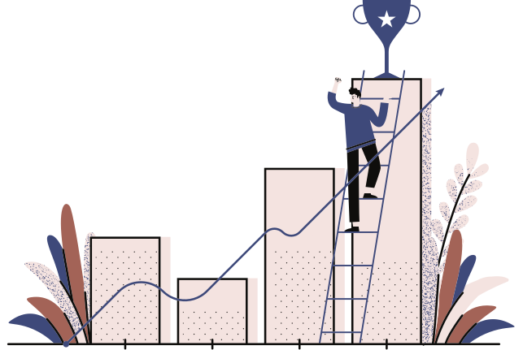
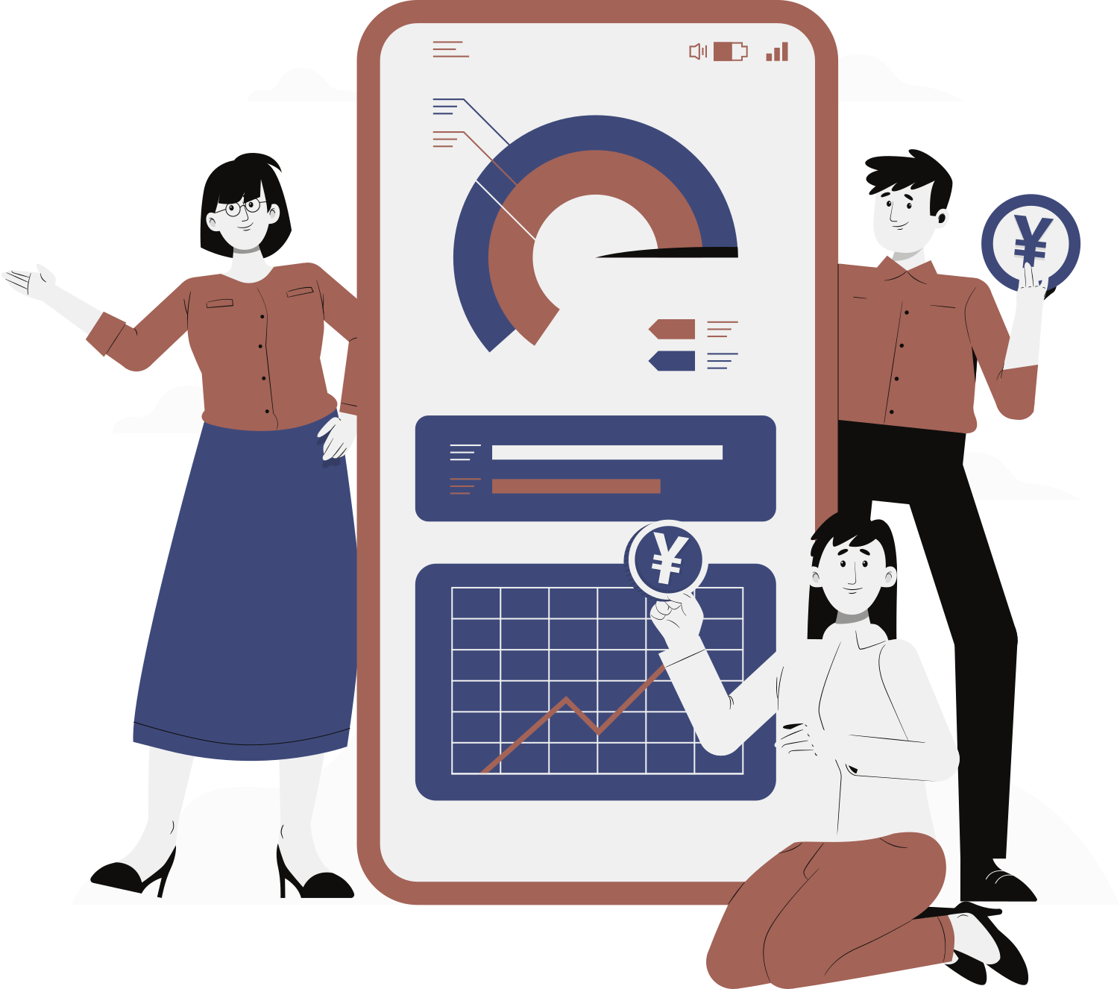
DIGITAL MARKETING
SEO is a part of digital marketing, here are other parts listed.
01
Search Engine Optimization (SEO)
05
Search Engine Marketing
02
Content Marketing
06
Instant Messaging Marketing
03
Social Media Marketing
07
Affiliate Marketing
04
Pay Per Click (PPC)
08
Email Marketing

Slide 18
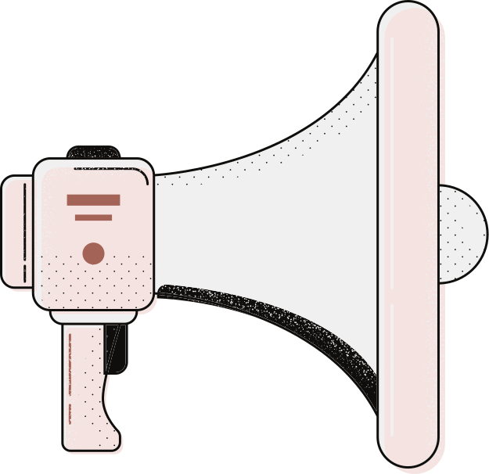



HOW IS SEO USED ?

Slide 19
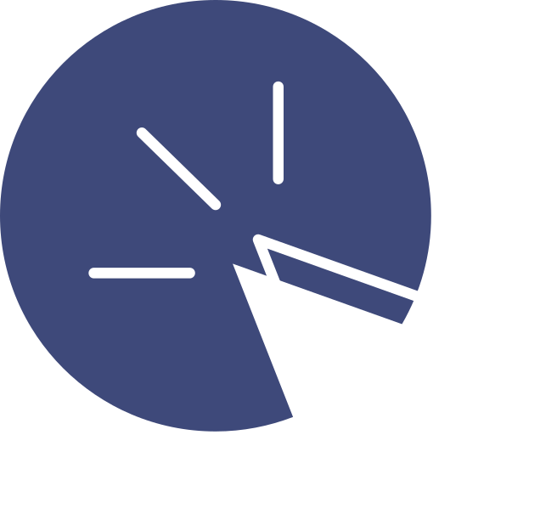
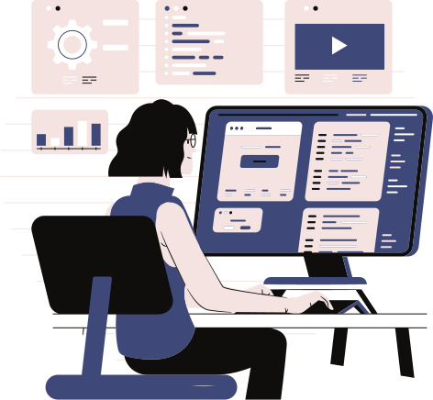
Search Engine
Optimization
(SEO)
QUALITY OF CONTENT
MOBILE-FRIENDLINESS
Any marketing that uses electronic
devices and can be used by marketing
specialists to convey promotional
messaging and measure its impact
through your customer journey.
In practice, digital marketing typically
refers to marketing campaigns
that appear on a computer, phone,
tablet, or other device.
Any marketing that uses electronic
devices and can be used by marketing
specialists to convey promotional
messaging and measure its impact
through your customer journey.
In practice, digital marketing typically
refers to marketing campaigns
that appear on a computer, phone,
tablet, or other device.
LEVEL OF USER
ENGAGEMENT
NUMBER AND QUALITY
OF INBOUND LINKS
Any marketing that uses electronic
devices and can be used by marketing
specialists to convey promotional
messaging and measure its impact
through your customer journey.
In practice, digital marketing typically
refers to marketing campaigns
that appear on a computer, phone,
tablet, or other device.
Any marketing that uses electronic
devices and can be used by marketing
specialists to convey promotional
messaging and measure its impact
through your customer journey.
In practice, digital marketing typically
refers to marketing campaigns
that appear on a computer, phone,
tablet, or other device.

Slide 20
GROUNDWORK OF SEO
SEARCH ENGINE OPTIMIZATION
Website Audit: Conduct a comprehensive audit of your website to identify any technical issues, such as broken links, duplicate content, or slow page speed. Use tools like Google Search Console, SEMrush Site Audit, or Screaming Frog to identify and fix these issues.
On-Page Optimization: Optimize your website's on-page elements, including titles, meta descriptions, headings, and image alt tags, to include your target keywords and improve relevance for search engines. Ensure that your content is well-structured, informative, and engaging for users.
Keyword Research: Start by conducting thorough keyword research to identify the terms and phrases that your target audience is searching for. Use tools like Google Keyword Planner, SEMrush, or Ahrefs to discover relevant keywords with high search volume and low competition.
Competitor Analysis: Analyze your competitors' websites to understand their SEO strategies, including the keywords they're targeting, their content quality, and their backlink profiles. This will help you identify opportunities and areas for improvement.

Slide 21
GROUNDWORK OF SEO
SEARCH ENGINE OPTIMIZATION
Local SEO: If you have a physical location or serve a specific geographic area, optimize your website for local search by claiming and optimizing your Google My Business listing, obtaining local citations, and encouraging customer reviews.
Mobile Optimization: Ensure that your website is mobile-friendly and responsive, as Google prioritizes mobile-friendly websites in its search rankings. Test your website's mobile usability and make any necessary adjustments to improve the user experience on mobile devices.
Content Creation: Develop high-quality, relevant content that addresses the needs and interests of your target audience. Create a content calendar and regularly publish blog posts, articles, videos, or other types of content that align with your target keywords and business goals.
Link Building: Implement a link building strategy to acquire high-quality backlinks from authoritative websites in your industry. This can include guest blogging, outreach campaigns, and participation in online communities or forums.

Slide 22
Paid Advertisements: Above or alongside the organic results, search engines may display paid advertisements (also known as sponsored links or PPC ads). These ads are typically labeled as "Ad" or "Sponsored" and are served based on keywords selected by advertisers and their bidding strategy.
Featured Snippets: Sometimes, Google displays a featured snippet at the top of the search results, providing a direct answer to the user's query in a box format. Featured snippets can include text, lists, tables, or other types of content extracted from web pages.
Knowledge Graph: Google's Knowledge Graph panel appears on the right side of the SERP (for desktop users) or at the top of the page (for mobile users) and provides quick answers to factual queries, such as information about people, places, or events.
SERP ANATOMY
Search Box: At the top of the page is the search box where users can enter their query.
Search Results: The main section of the SERP displays the search results, typically organized in a list format. Each result typically includes a title, URL, and snippet of text (meta description) that provides a brief summary of the page's content.
Organic Results: These are non-paid search results that are generated based on the search engine's algorithmic ranking process. Organic results are usually displayed below any paid advertisements and may include web pages, blog posts, news articles, videos, or other types of content.

Slide 23
SERP ANATOMY
Related Searches: At the bottom of the SERP, Google may display a list of related searches, suggesting additional queries related to the user's original search term.
Local Pack (for Local Searches): For location-based searches, Google may display a local pack featuring a map and a list of nearby businesses related to the user's query. Each listing typically includes the business name, address, phone number, and reviews.
Understanding the anatomy of a SERP is crucial for SEO professionals and website owners as it helps them optimize their content and improve their visibility in search engine results. By optimizing for relevant keywords, creating high-quality content, and adhering to best SEO practices, websites can increase their chances of ranking prominently in SERPs and attracting organic traffic.

Slide 24
CRAWLING, CATCHING, INDEXING
Caching: Caching refers to the practice of temporarily storing copies of web pages on a search engine's servers or in its cache memory. When a crawler visits a web page, it may cache a copy of the page's content to expedite future retrieval and reduce server load. Cached versions of web pages can be served to users in search results, providing a faster and more responsive browsing experience. However, it's important to note that caching doesn't always occur for every page crawled, and search engines may prioritize caching for pages with higher relevance or authority.
Indexing: Indexing is the process of organizing and storing the information collected by crawlers in a searchable database, known as the search engine's index. During indexing, the search engine analyzes the content of each web page, extracts relevant keywords, and assigns them to specific entries in its index
Crawling: Crawling is the process by which search engine bots, also known as crawlers or spiders, systematically browse the web to discover and retrieve content from web pages. These bots follow links from one page to another, traversing the interconnected network of the internet. They collect data about each page they visit, including its URL, content, meta tags, and links to other pages. Crawling allows search engines to find new pages, revisit existing ones, and update their index with fresh information.

Slide 25
Meta Tags:
Meta tags are HTML elements that provide metadata about a web page, such as its title, description, and keywords.
The <title> tag is perhaps the most crucial meta tag for SEO, as it appears as the clickable headline in search engine results pages (SERPs) and influences click-through rates.
The <meta name="description"> tag provides a brief summary of the page's content in SERPs, helping users understand what the page is about.
While meta keywords (<meta name="keywords">) are no longer considered a significant ranking factor, they can still be used to indicate the primary topics of a page to search engines.
METATAGS:

Slide 26
Header Tags:
Header tags (e.g., <h1>, <h2>, <h3>, etc.) are HTML elements used to define headings and subheadings within a web page's content.
Header tags provide structure and hierarchy to the content, making it easier for users and search engines to understand the organization of the page.
The <h1> tag is typically used for the main page title or headline and carries the most weight in terms of SEO. Subsequent header tags (<h2>, <h3>, etc.) are used for subheadings and should be nested hierarchically.
HEADER TAGS:

Slide 27
Alt Tags:
Alt tags (or alt attributes) are HTML attributes used to describe the content of images on a web page.
Alt tags serve two main purposes: they provide accessibility for visually impaired users who use screen readers to browse the web, and they provide context to search engines about the content of images.
Including relevant keywords in alt tags can help improve the page's relevance for those keywords in image search results.
Alt tags should accurately describe the content of the image in a concise and descriptive manner.
ALT TAGS:

Slide 28
TECHNICAL SEO:
2 .Mobile Friendliness: With the increasing prevalence of mobile devices, it's essential for websites to be optimized for mobile viewing. This includes implementing responsive design principles, using mobile-friendly fonts and buttons, and ensuring that content is easily accessible and readable on small screens.
2. Crawlability and Indexability: Search engine bots need to crawl and index a website's content to include it in search results. Technical SEO involves optimizing robots.txt files to control which pages are crawled, fixing crawl errors, and using canonical tags to prevent duplicate content issues.
3. Site Structure and Navigation: A well-organized site structure makes it easier for both users and search engines to navigate and understand the content. Technical SEO efforts include optimizing URL structure, creating XML sitemaps, and implementing breadcrumb navigation.
Technical SEO refers to the optimization of a website's technical aspects to improve its search engine visibility and performance. Unlike on-page SEO, which focuses on content and user experience, technical SEO deals with backend elements and infrastructure. Here are some key components of technical SEO:
Website Speed Optimization: Ensuring that the website loads quickly is crucial for user experience and search engine rankings. This involves optimizing images, minifying CSS and JavaScript files, leveraging browser caching, and utilizing content delivery networks (CDNs) to reduce server response times.

Slide 29
TECHNICAL SEO:
Site Speed: Site speed is a critical factor in user experience and search engine rankings. Technical SEO techniques such as optimizing images, minifying CSS and JavaScript files, and leveraging browser caching can help improve site speed and performance.
Structured Data Markup: Implementing structured data markup using Schema.org vocabulary helps search engines understand the context and meaning of the content on a webpage. This can result in enhanced search results with rich snippets, such as star ratings, reviews, and product prices.
Canonicalization: Canonical tags (rel=canonical) are used to specify the preferred version of a webpage when multiple versions of the same content exist (e.g., HTTP vs. HTTPS, www vs. non-www). Canonicalization helps prevent duplicate content issues and consolidates link equity to the preferred version of the page.
Schema Markup: Schema markup is a structured data vocabulary that helps search engines understand the content of web pages better. Implementing schema markup can enhance search engine results with rich snippets, such as star ratings, product prices, and event dates.
HTTPS and Security: Google considers website security as a ranking factor, so it's essential to secure the site with HTTPS encryption. Technical SEO involves obtaining SSL certificates, redirecting HTTP to HTTPS, and implementing other security measures to protect user data and privacy.

Slide 30
DOMAIN AUTHORITY
Importance: Domain Authority is important because it provides an estimate of a website's overall authority and credibility in the eyes of search engines. Websites with higher DA scores tend to rank better in search results.
Relative Metric: Domain Authority is a relative metric, meaning it is best used for comparing websites against each other rather than as an absolute measure of ranking potential. It is also important to note that Domain Authority is specific to each individual website and not the entire domain.
Influence on Rankings: While Domain Authority is not a direct ranking factor used by search engines like Google, it correlates strongly with rankings. Websites with higher DA scores tend to have better visibility and higher positions in search results.
Domain Authority (DA) is a metric developed by Moz that predicts how well a website will rank on search engine results pages (SERPs). It is based on a logarithmic scale from 0 to 100, with higher scores indicating a greater likelihood of ranking well. Domain Authority is calculated by evaluating various factors, including the number of linking root domains, the quality and relevance of those links, and other link-related metrics.

Slide 31
DOMAIN AUTHORITY
Factors Affecting DA: Domain Authority is influenced by various factors, including the quality and quantity of inbound links, the relevance of those links to the website's content, the diversity of linking domains, and the overall authority of the linking domains.
Improving DA: To improve Domain Authority, website owners can focus on building high-quality, relevant backlinks from authoritative websites, creating valuable content that attracts natural links, and maintaining a healthy link profile. It's also essential to focus on overall website quality, user experience, and technical SEO factors.
.
Limitations: While Domain Authority is a useful metric for assessing a website's potential to rank in search results, it has limitations. It is just one of many factors that influence rankings, and it does not capture all aspects of a website's authority or relevance. Additionally, Domain Authority scores can fluctuate over time due to changes in the link landscape or updates to Moz's algorithms

Slide 32

:::THANK YOU:::
SUBMITTED BY: PRAHARSH VERMA

